Slide 1
Mark Hahnel – Founder, CEO

Slide 2
researchers
publishers
institutions

Slide 3
Interface

Slide 4
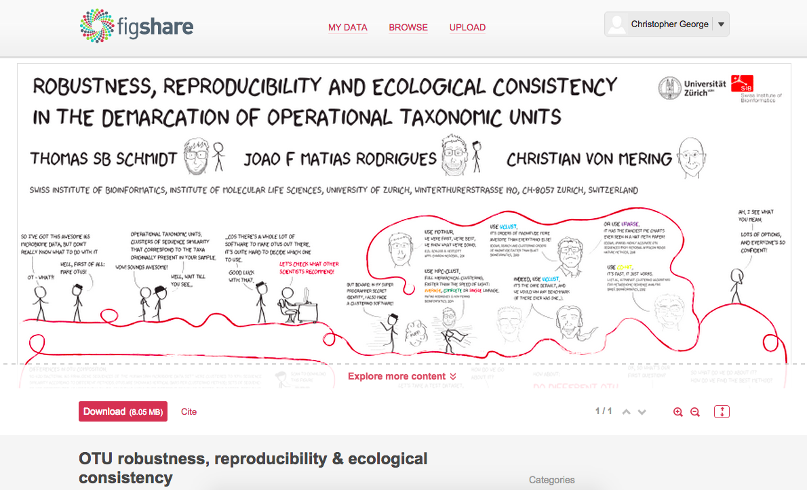
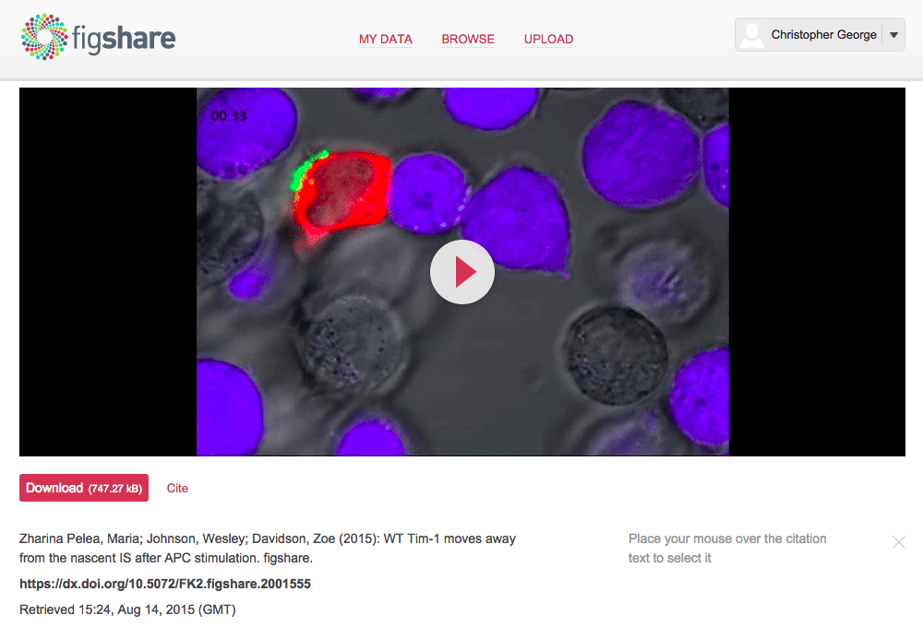
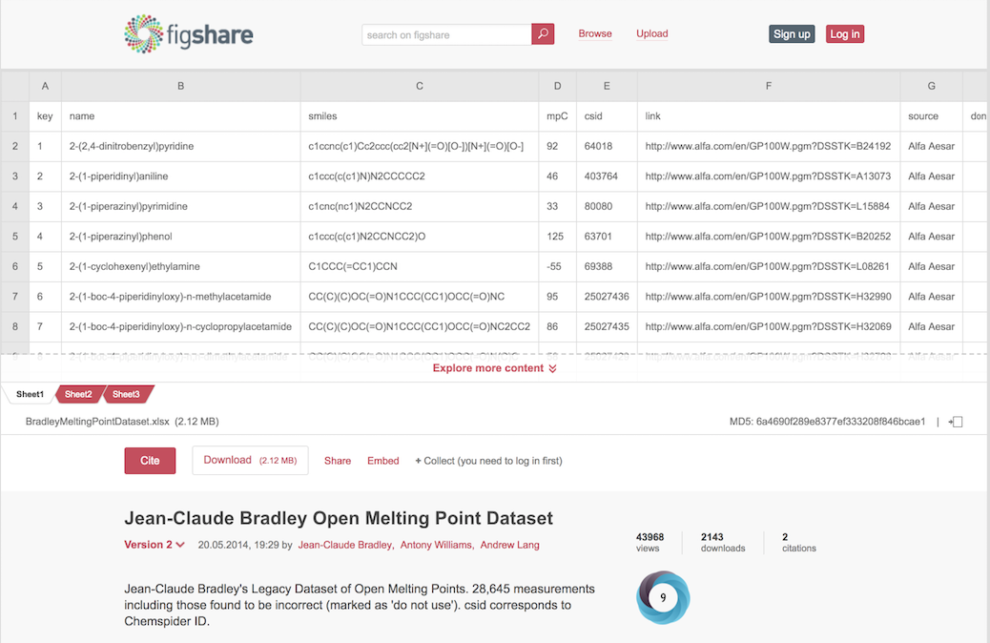
Notes:
What do we do – provide publishing platforms for all of academic files other than peer reviewed papers – started with NTROs

Slide 5
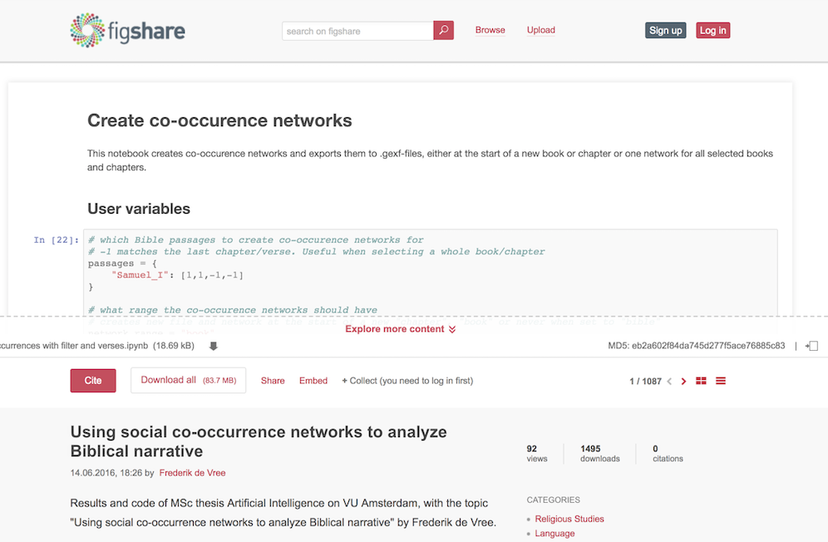
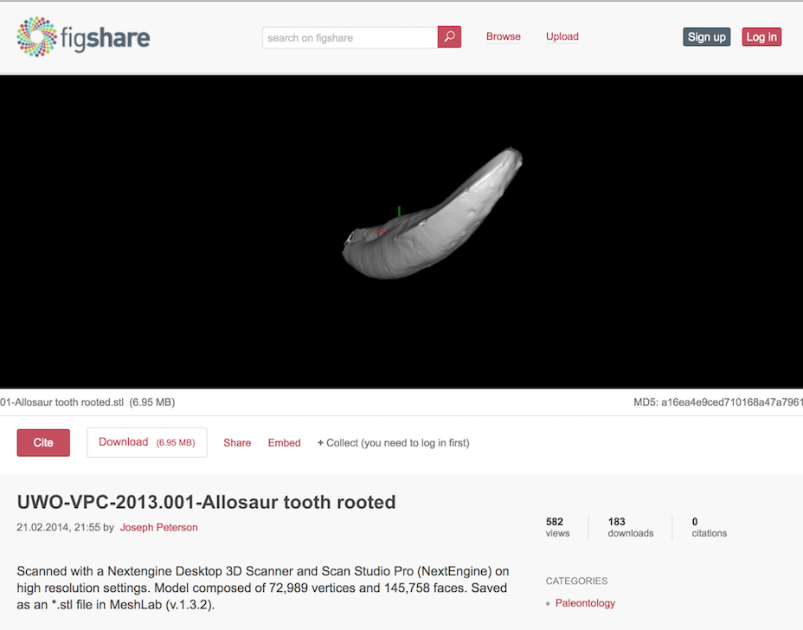
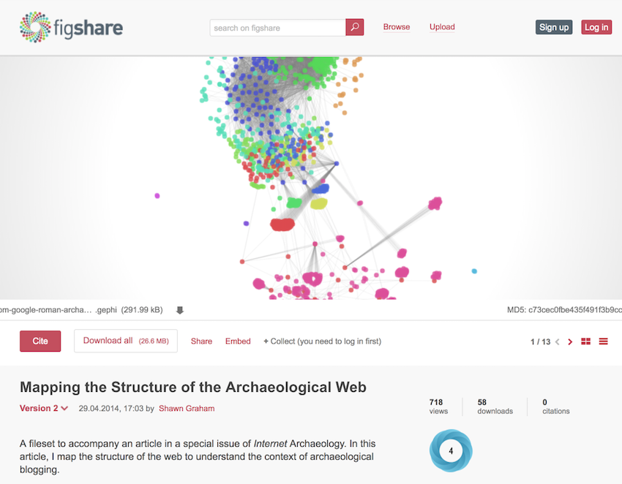
Notes:
What do we do – provide publishing platforms for all of academic files other than peer reviewed papers – started with NTROs

Slide 6
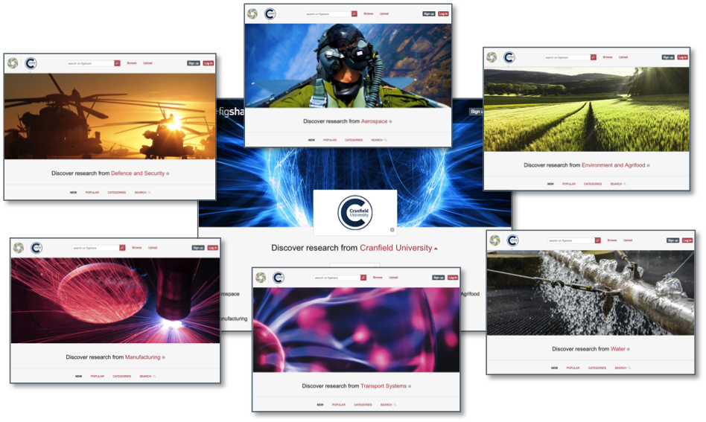

Slide 7
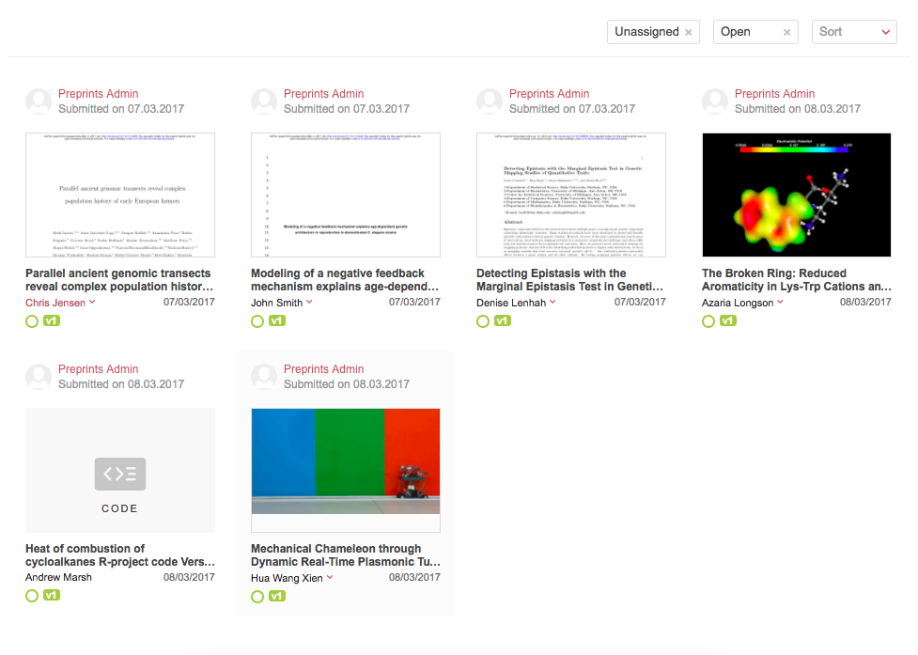

Slide 8
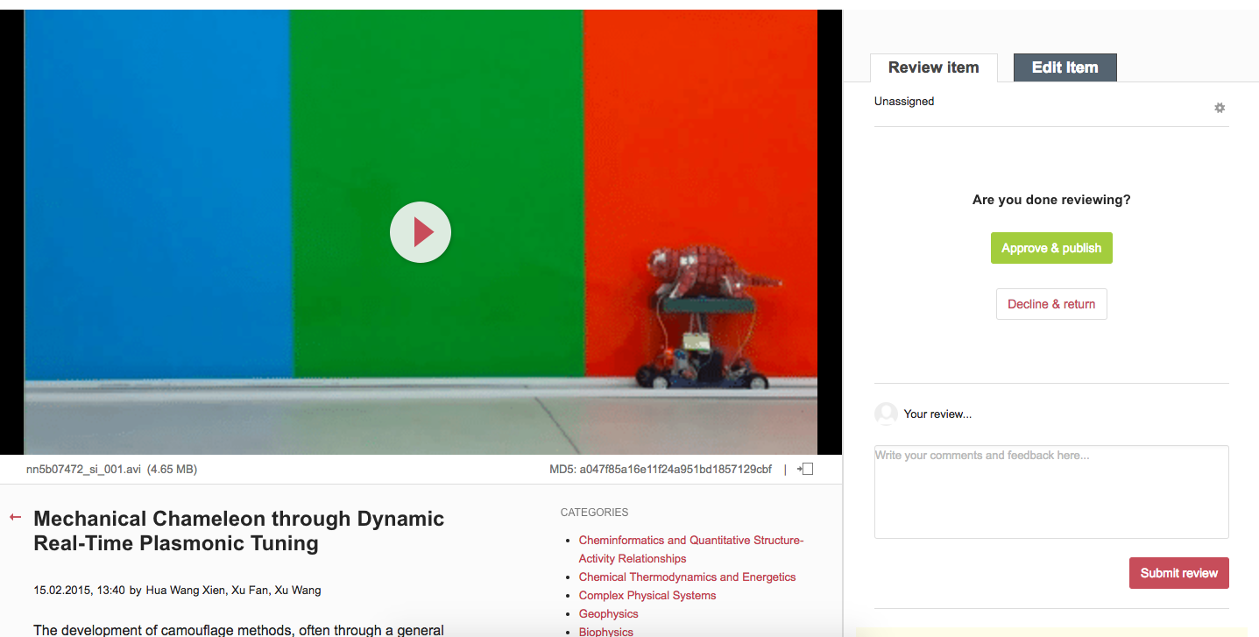

Slide 9
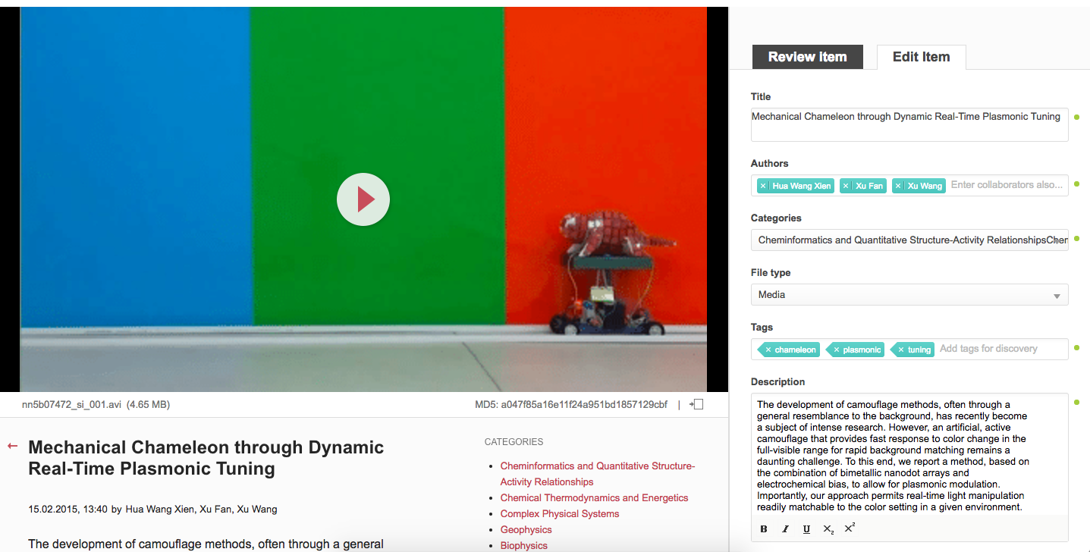

Slide 10
APIs

Slide 11
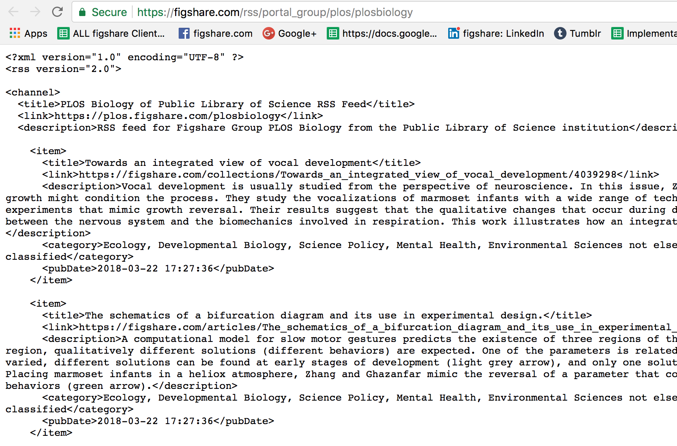

Slide 12
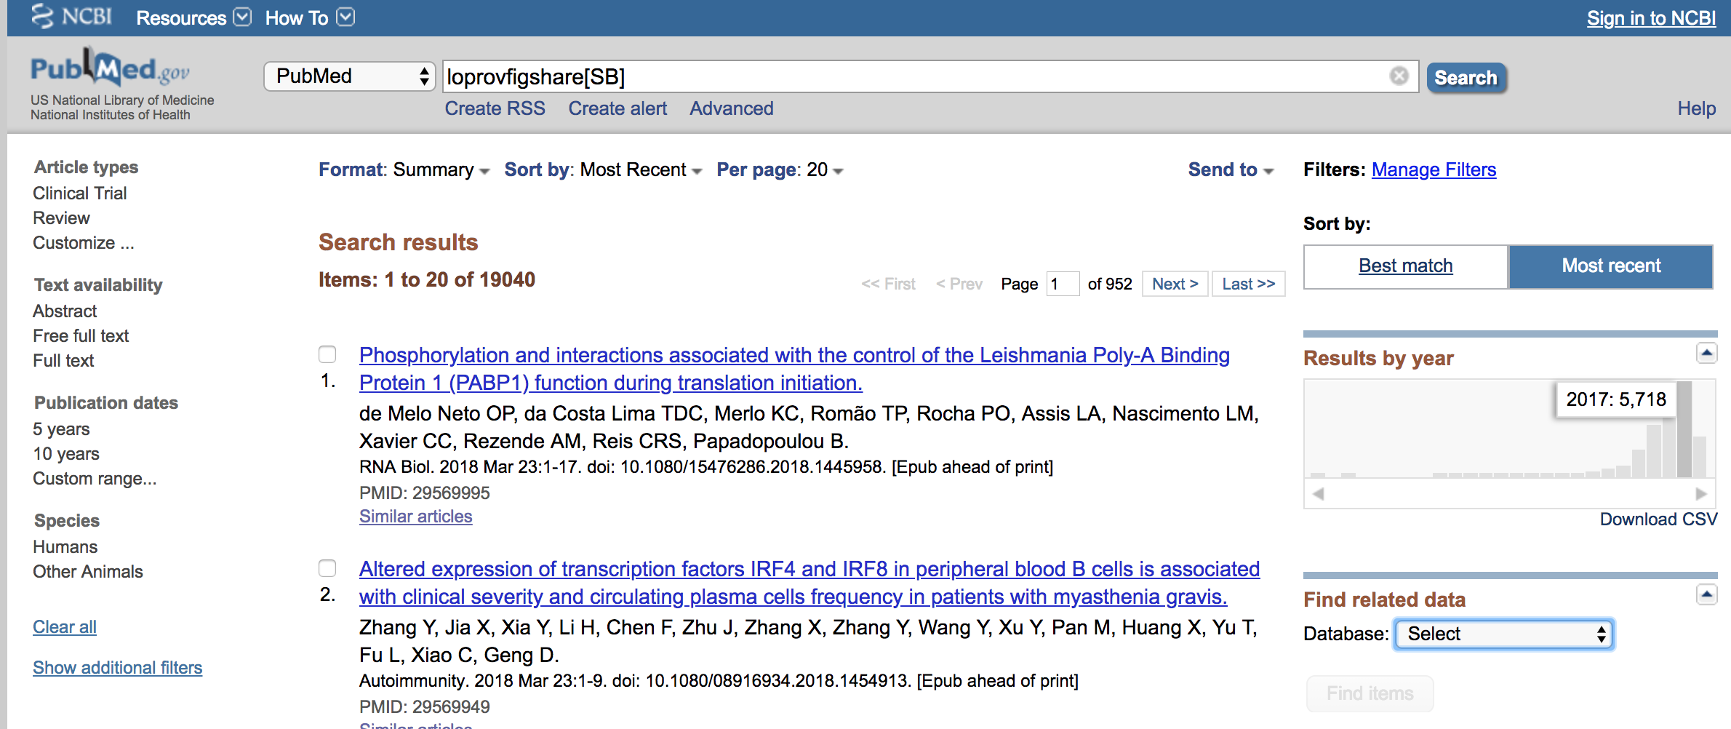

Slide 13
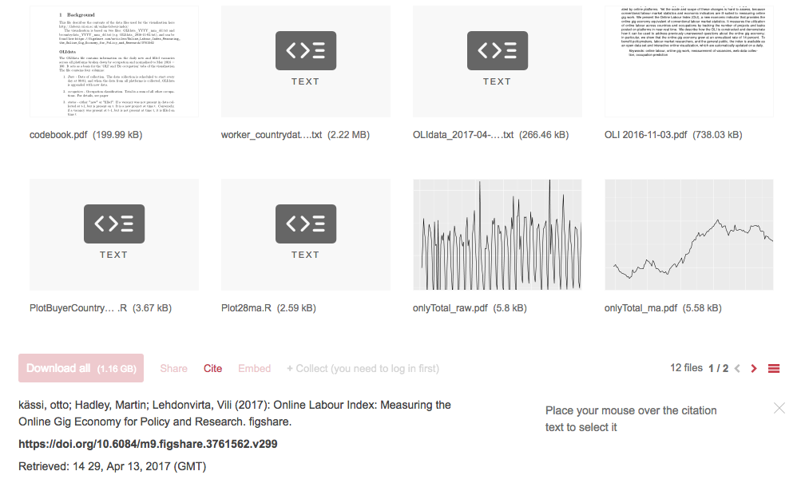
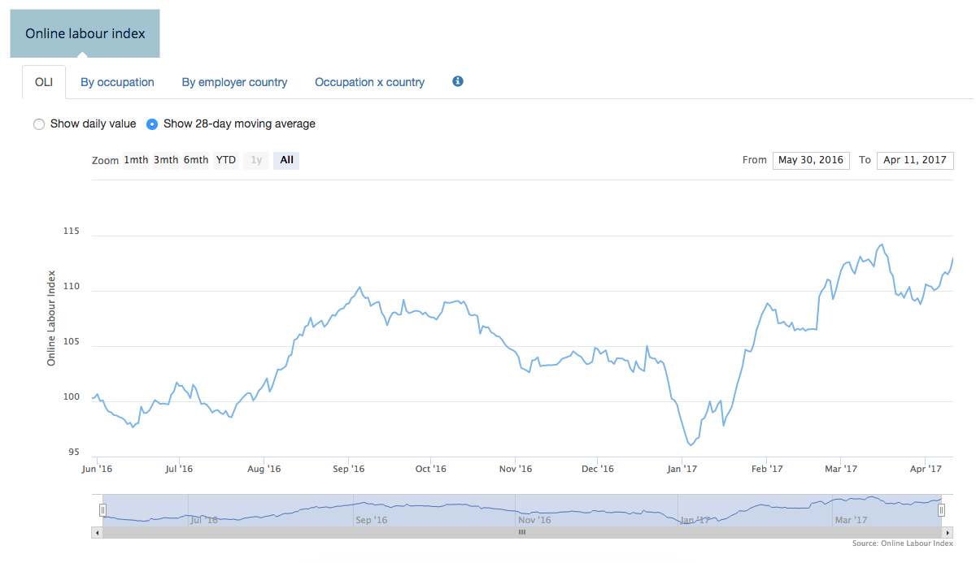
Notes:
78 portals

Slide 14
V. High level Infrastructure

Slide 15
Dev Team
User
Single Distributed Codebase
Push
Infrastructure
Interface
Upload
Download
Aus
EU
Russia
Storage
Buckets
Cloud
Local
Notes:
BePress and SSRN

Slide 16
Dev Team
User
Policy Compatible Infrastructure
Push
Infrastructure
Interface
Upload
Download
Aus
EU
Russia
Storage
Buckets
Cloud
Local
Notes:
BePress and SSRN

Slide 17
Dev Team
User
Uniform
User
Experience
Pull
Infrastructure
Interface
Upload
Download
Aus
EU
Russia
Storage
Buckets
Cloud
Local
Notes:
BePress and SSRN

Slide 18
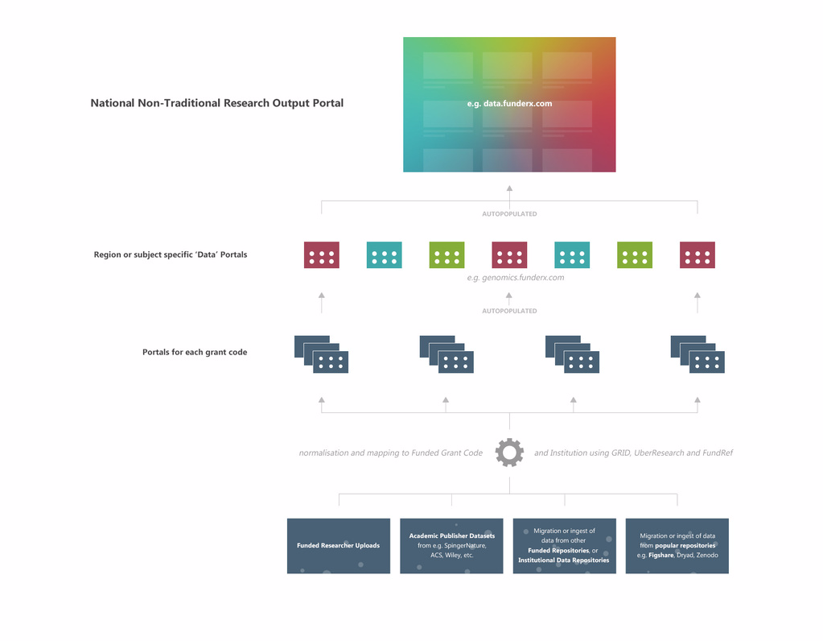

Slide 20
Mark Hahnel
Function: CEO
email: mark@figshare.com
@markhahnel
@figshare
Igor Osipov
Email: i.osipov@digital-science.com

